Slide 1

24 Energy Story Ideas You Can Do Right Now
Data Driven
Localizable
Timely
JORDAN WIRFS-BROCK, @jordanwb
DAN BOYCE, @boycedan
STEPHANIE JOYCE, @stephaniemjoyce
LEIGH PATERSON, @sclaterpee
REBECCA JACOBSON, @rebeccajacobson
CAR 2016, Denver

Slide 2

Energy? But that’s too…
Boring
Nerdy
Businessy
Jargony
Boring
Complex
Politicized
Esoteric
Boring
Irrelevant
Unsexy
Wonky
Boring

Slide 3

PICKLE!
HALF SOUR

Slide 4
1. How Much Electricity Do You Use?
http://insideenergy.org/2016/02/23/boiling-water-ieq/
Notes:
Rebecca

Slide 5
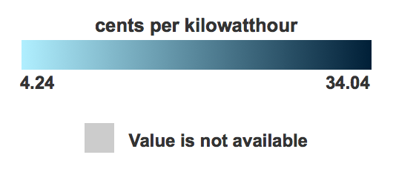
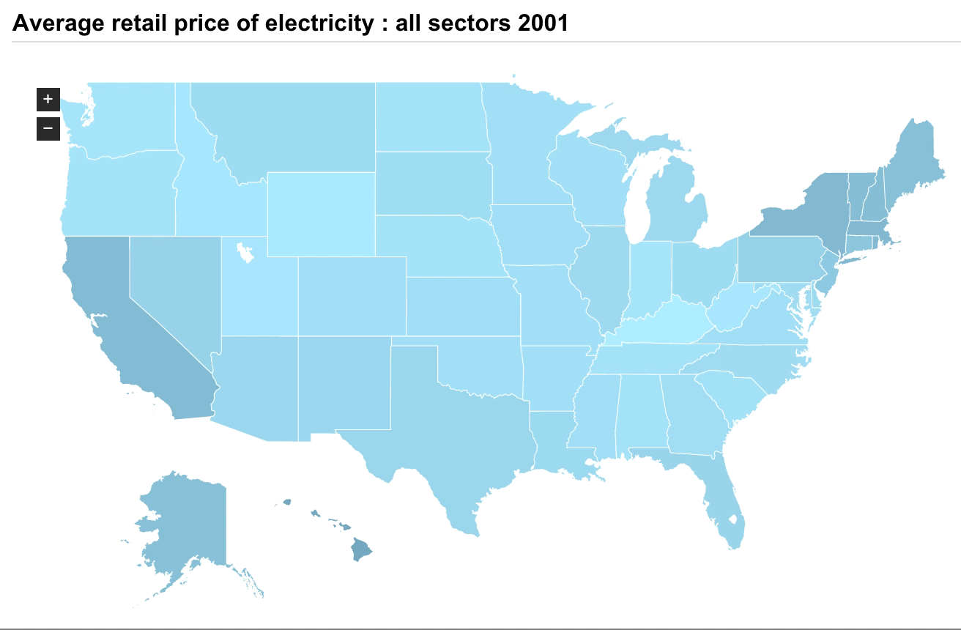
2. And What’s The Price Of Your Kilowatt Hour?
Source: EIA, http://bit.ly/kWhprice
Notes:
Stephanie

Slide 6
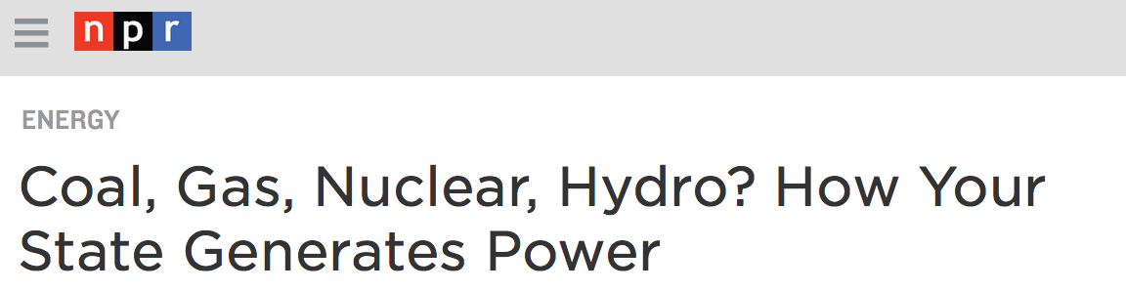
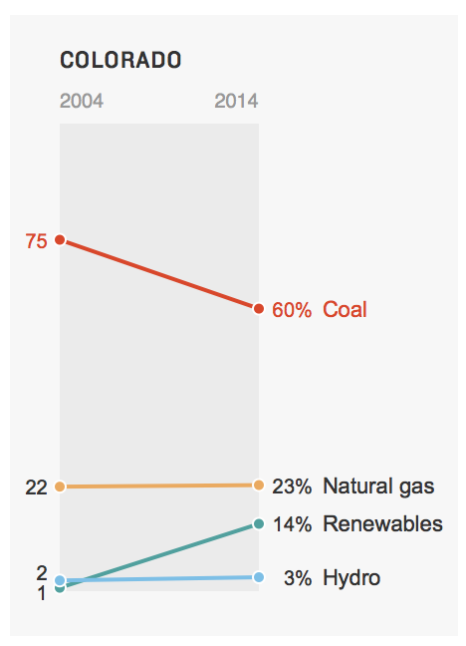
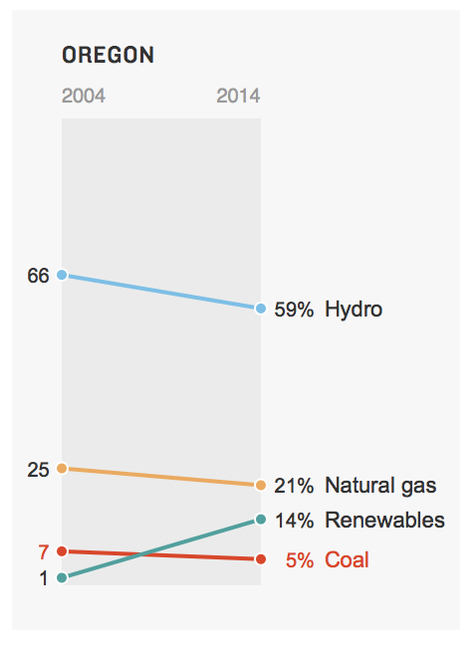
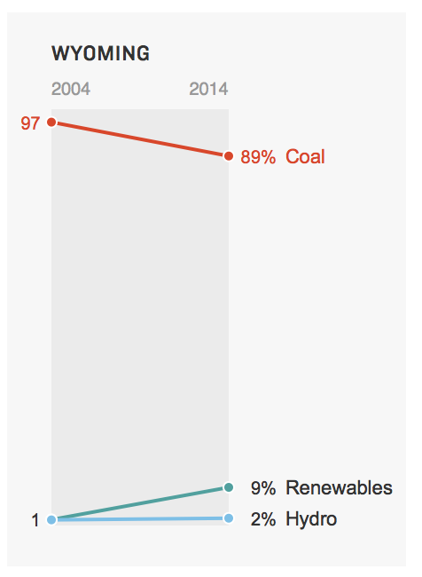
3. And Where Does It Come From…?
http://www.npr.org/2015/09/10/319535020/coal-gas-nuclear-hydro-how-your-state-generates-power
Notes:
Jordan

Slide 7
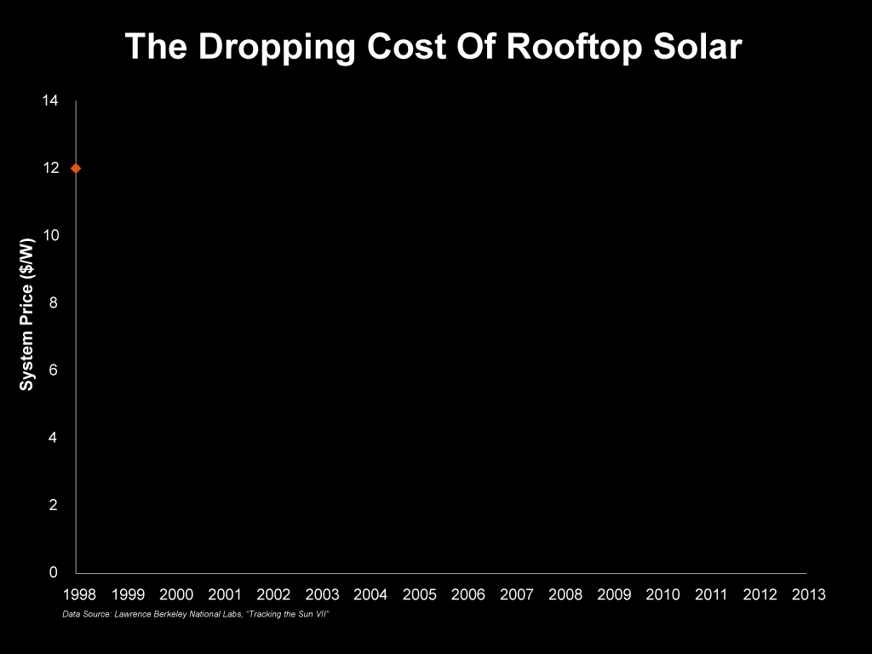
4. Whatever Happened to Rooftop Solar?
http://insideenergy.org/series/the-solar-challenge/
Notes:
Dan

Slide 8
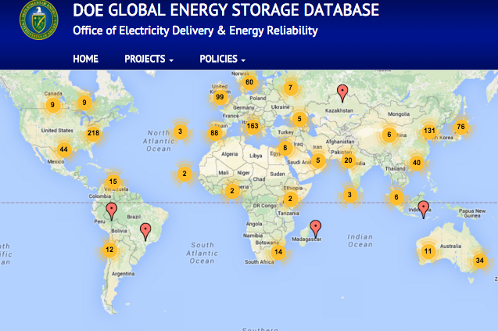
5. Energy Storage: Are We There Yet?
http://www.energystorageexchange.org/projects
Notes:
Leigh

Slide 9
6. Smart Meters And The Internet of Things
https://www.eia.gov/todayinenergy/detail.cfm?id=8590
Notes:
Dan

Slide 10
7. When
the Power Goes Out…
http://insideenergy.org/2015/03/20/ie-questions-how-long-is-your-blackout/
Notes:
Leigh

Slide 11
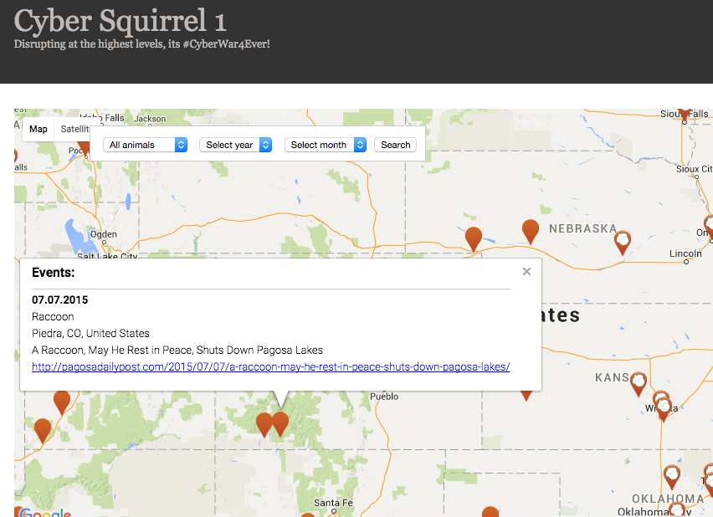
8. Those Pesky Squirrels
http://www.cybersquirrel1.com/
Notes:
Stephanie

Slide 12

9. Who Resurrected The Electric Car?
http://www.bloomberg.com/features/2016-ev-oil-crisis/
Notes:
Rebecca

Slide 13
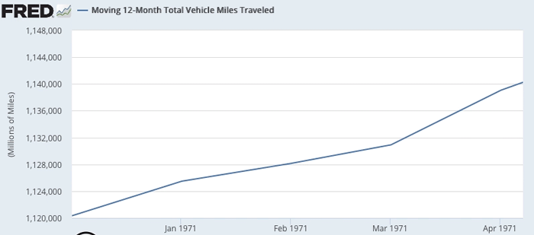
10. How Much Do We Drive?
https://research.stlouisfed.org/fred2/series/M12MTVUSM227NFWA
Notes:
Dan

Slide 14
11. Gas Taxes, Love ’Em Or Hate ’Em?
http://www.api.org/oil-and-natural-gas-overview/industry-economics/fuel-taxes/gasoline-tax
Notes:
Rebecca

Slide 15

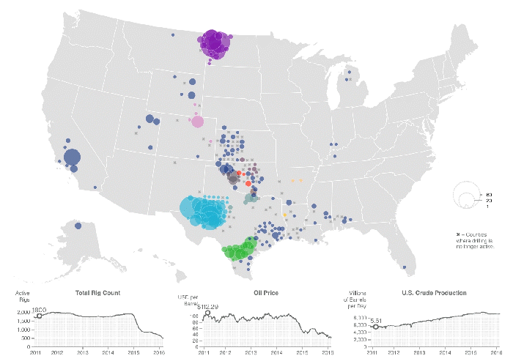
12. Why Is Everyone Always Talking About
Rig Count?
http://www.bloomberg.com/graphics/2016-oil-rigs/
Notes:
Leigh

Slide 16
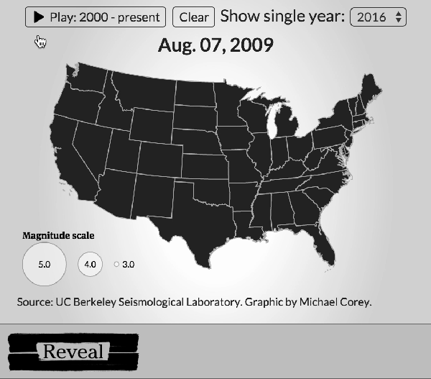

13. Earthquakes And Oil And Gas
https://www.revealnews.org/article/watch-oklahomas-earthquake-explosion/
https://www.revealnews.org/article/listen-to-the-music-of-seismic-activity-in-oklahoma/
Notes:
Jordan

Slide 17
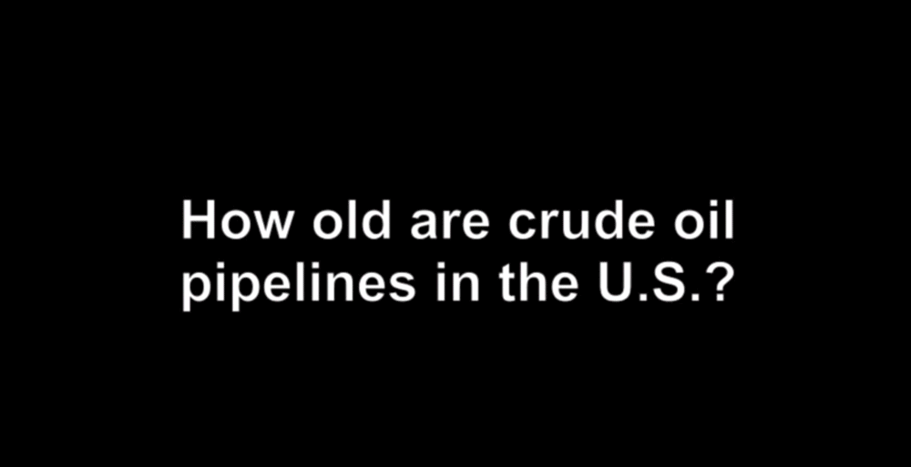
14. Pipelines: Hidden Fluid Highways
http://insideenergy.org/2014/08/01/half-century-old-pipelines-carry-oil-and-gas-load/
Notes:
Stephanie

Slide 18
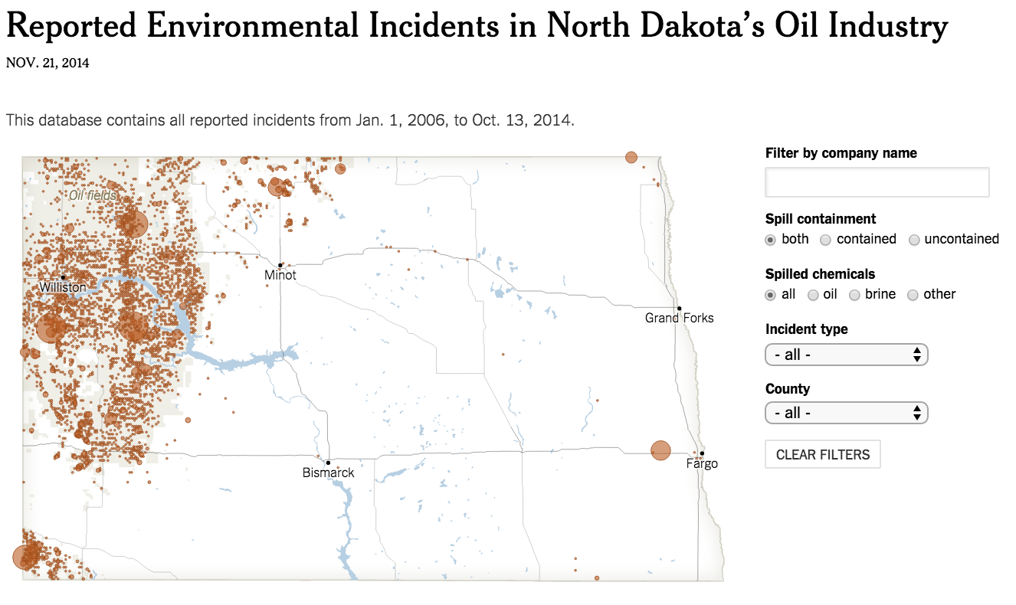
15. Spills Happen
http://www.nytimes.com/interactive/2014/11/23/us/north-dakota-spill-database.html?_r=0
Notes:
Jordan

Slide 19
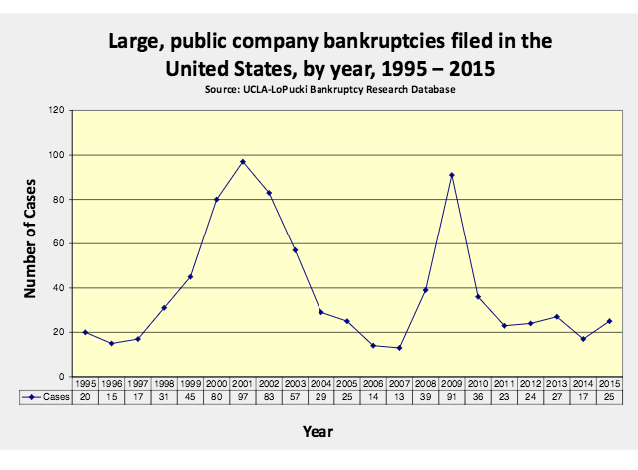
16. So Do Bankruptcies
http://lopucki.law.ucla.edu/
Notes:
Leigh

Slide 20
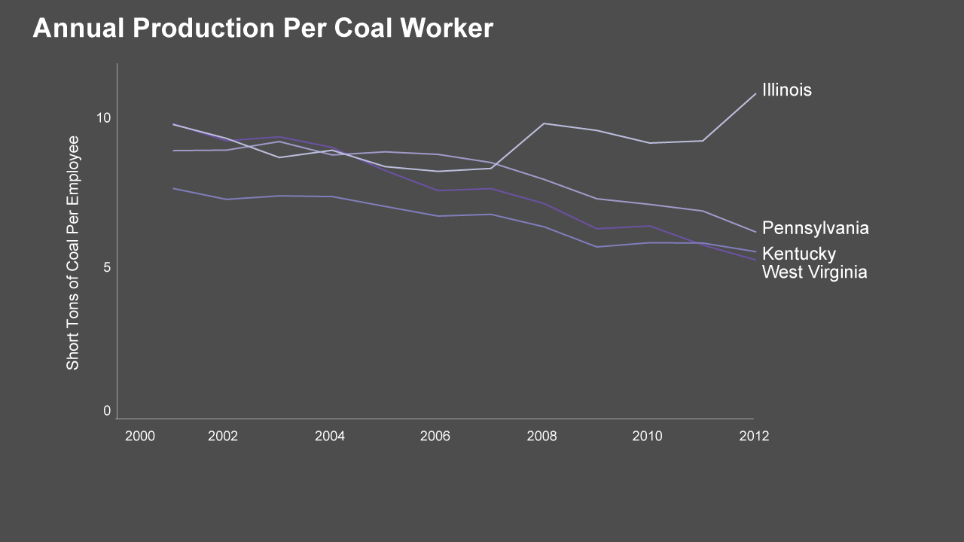
17. Jobs: Who Works In Energy?
http://insideenergy.org/2015/04/28/ie-questions-in-wyoming-how-much-coal-does-a-miner-mine/
Notes:
Dan

Slide 21
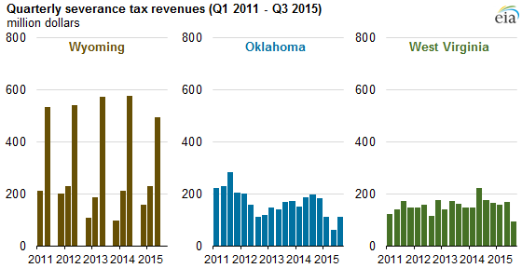
18. Quantifying The Collapse of Coal
http://www.eia.gov/todayinenergy/detail.cfm?id=24512
Notes:
Leigh

Slide 22
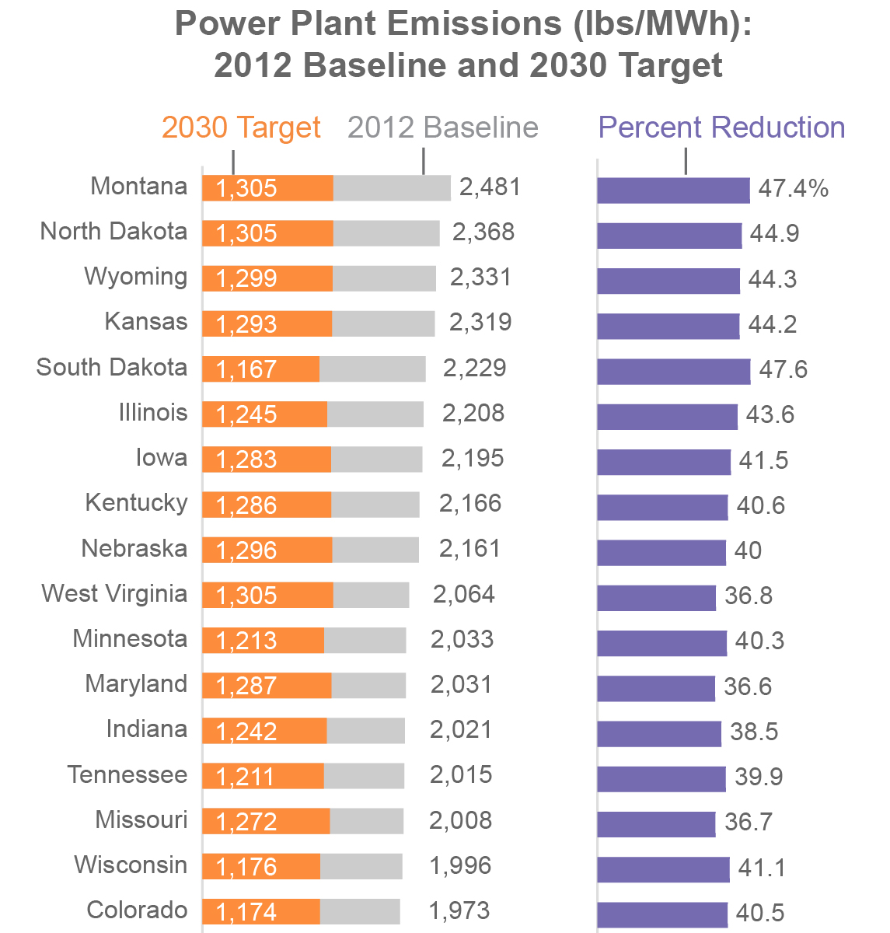
19. So About The Clean Power Plan…
Data Source: U.S. EPA; Graphic: Inside Energy, http://bit.ly/cleanpowerplanvisual
Notes:
Stephanie

Slide 23
20. Energy Money In Politics
http://insideenergy.org/2014/10/23/more-money-to-fight-over-more-money-to-fight-with-north-dakota-politics-transformed/
Notes:
Rebecca

Slide 24
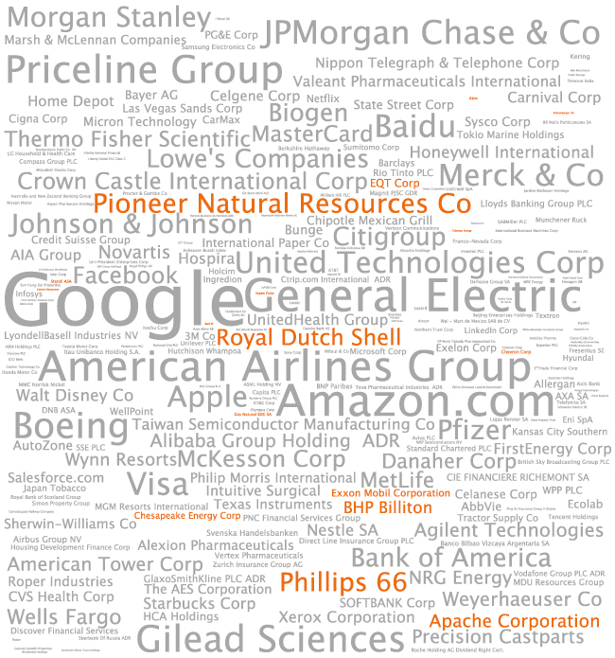
21.
Energy Money
In Your Investments
http://insideenergy.org/2014/11/12/who-owns-oil-and-gas/
Notes:
Dan

Slide 25
22. What Do The 10-Ks Say?
Understanding how debt plays into the web of a company's finances was a beast - nay, a monster. We faced the Debt Monster with only 10-Ks to protect us.
http://insideenergy.org/2015/01/21/slaying-the-debt-monster-finances-of-10-oil-and-gas-companies-in-colorado/
Notes:
Leigh

Slide 26
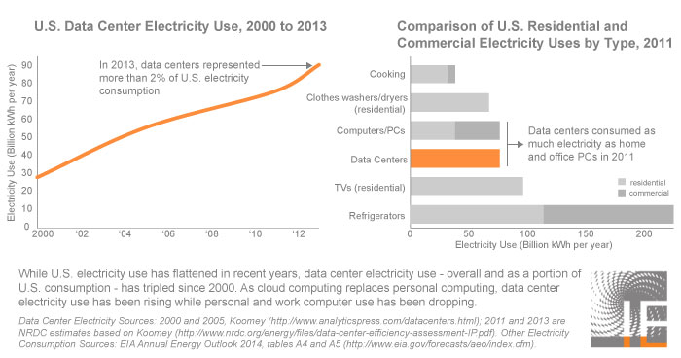
23. How Big Is The Internet’s Electricity Bill?
http://insideenergy.org/2015/01/27/wyoming-hosts-first-waste-powered-data-center-in-u-s/
Notes:
Jordan

Slide 27

24. Take A Big Bite Of Energy
http://insideenergy.org/2015/12/08/quiz-how-much-energy-does-it-take-to-make-your-food/
Notes:
Stephanie

Slide 28


Your Energy Questions, Answered.

Slide 29

This is just the beginning.
Tip sheet! Notes, data sources and ideas for each of the examples in this presentation:
https://github.com/InsideEnergy/24-energy-stories-CAR16
Data Battery! Data we’ve cleaned and analyzed, along with notes and code:
https://github.com/InsideEnergy/Data-for-stories
Peek in our notes! Our go-to energy data sources:
http://bit.ly/IEDataResources

Slide 30
We want to nerd out about energy with you. Get in touch.
JORDAN WIRFS-BROCK | @jordanwb
DAN BOYCE | @boycedan
STEPHANIE JOYCE | @stephaniemjoyce
LEIGH PATERSON | @sclaterpee
REBECCA JACOBSON | @rebeccajacobson
insideenergy.org

